Slide 1
Team - print(”Hello world“)

Slide 2
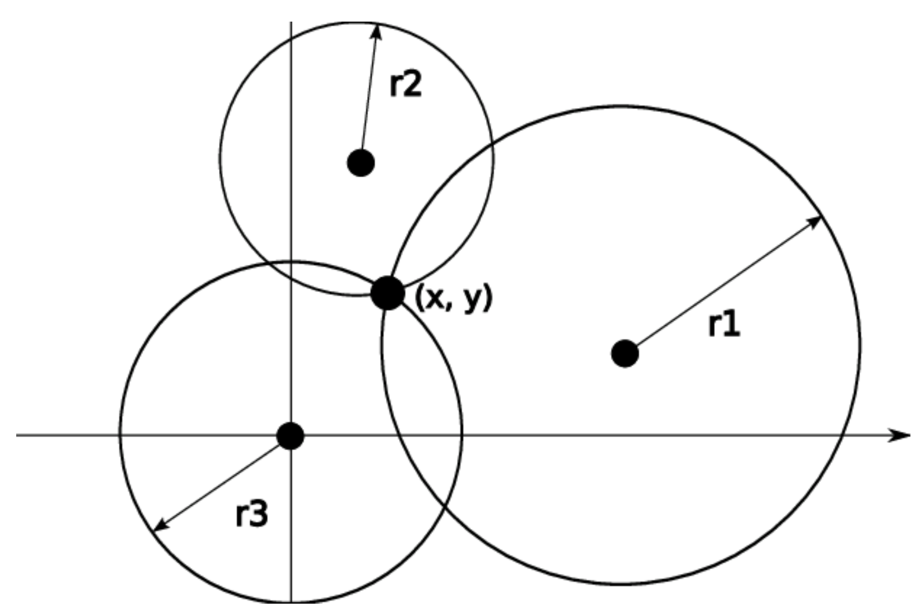
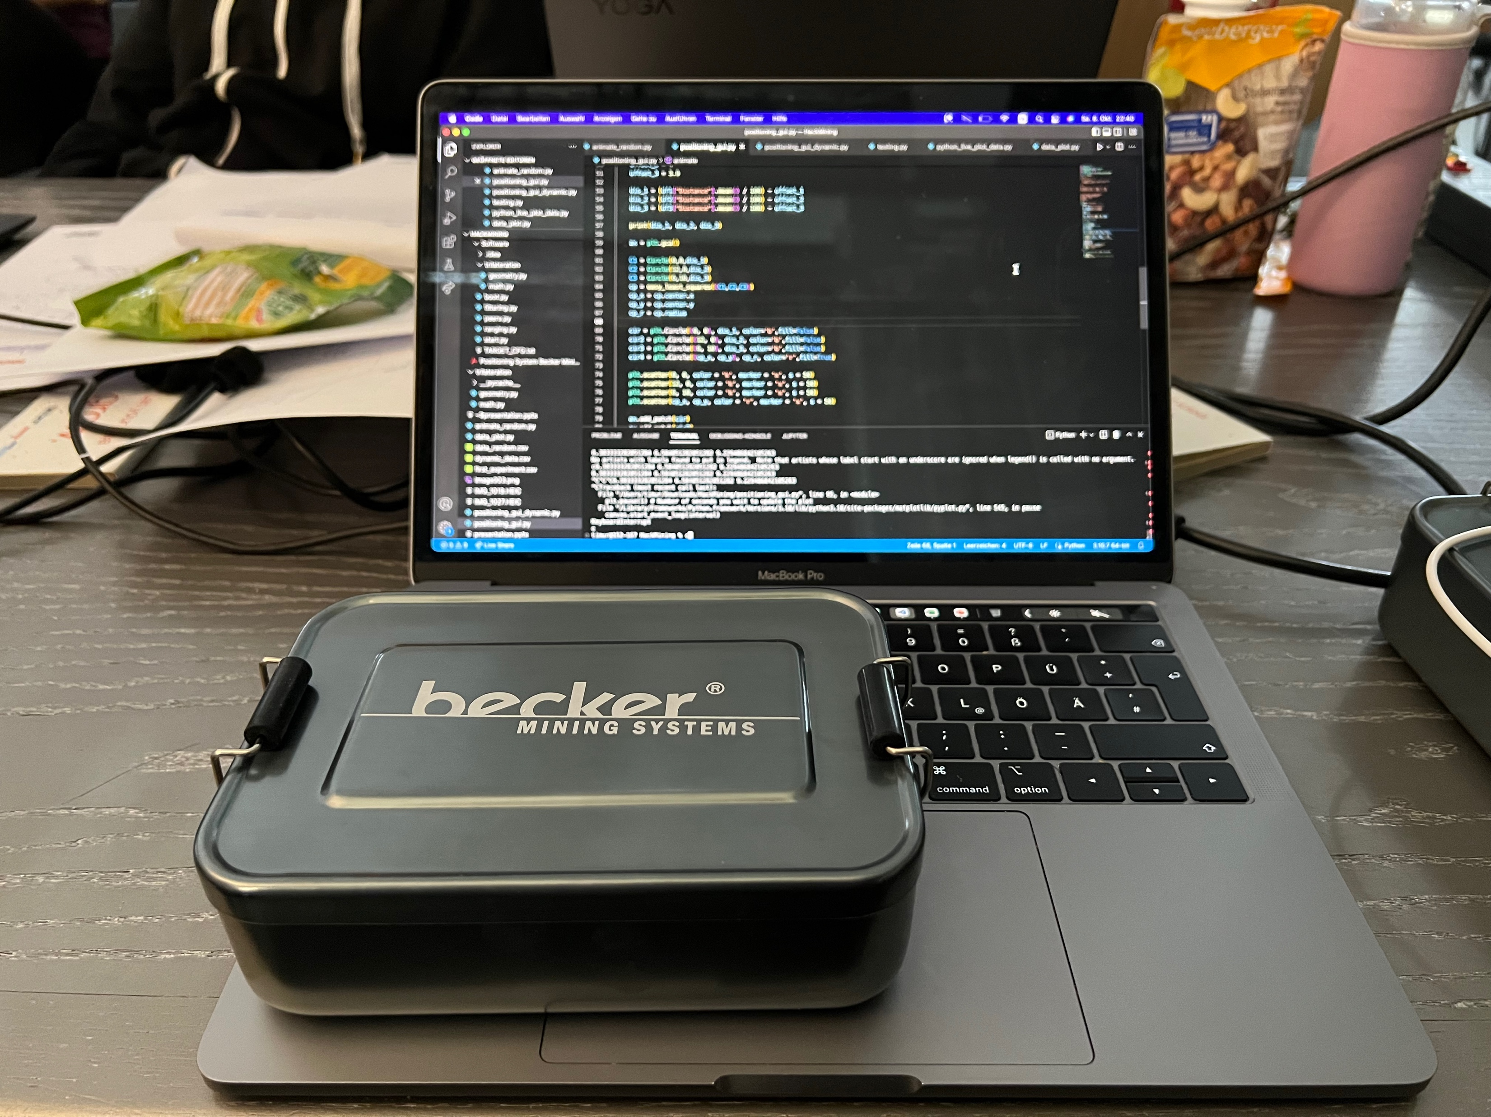
Becker Possys 4.0 - Challenge description
Validation system for PDS4.0
collision awareness and proximity detection
Position of target between fixed anchors should be determined
Results should be displayed in graphical user interface
Anchor 3
Target
Anchor 2
Anchor 1

Slide 3
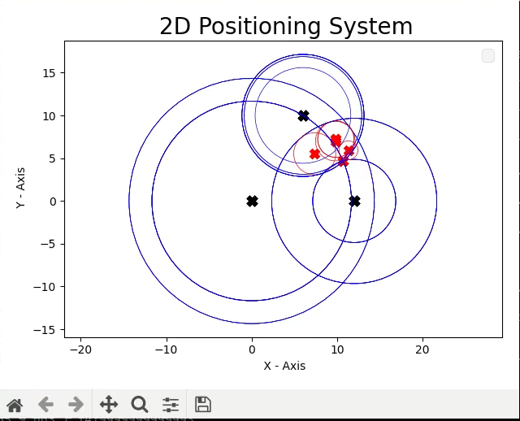
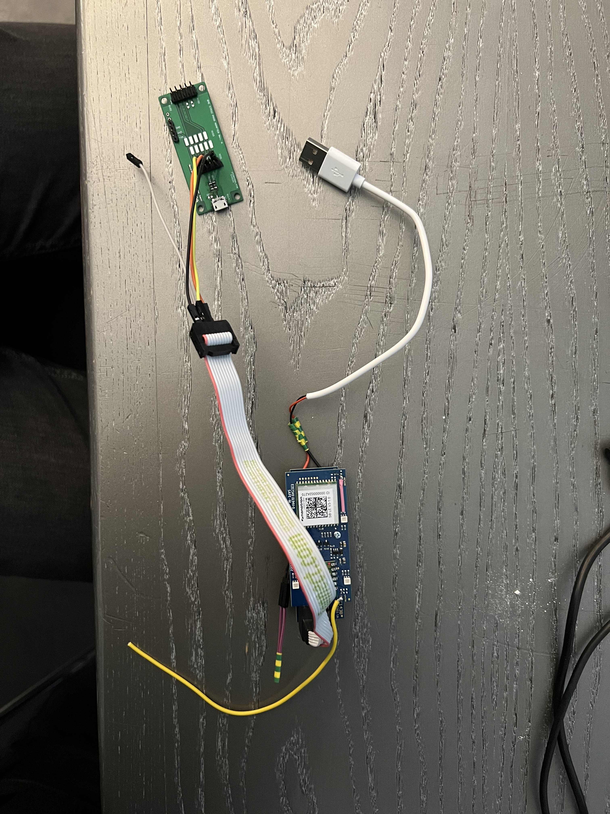
DATA Flow from sensor to visualization
Raspberry Pi Pico
CSV
GUI
Timestamp (s) | Anchor (hex) | Distance (cm)
1 | 0x1F2DC | 1129
2 | 0x1F084 | 1017
3 | 0x1EBEE | 1204
4 | 0x1F2DC | 1144
5 | 0x1F084 | 1021
6 | 0x1EBEE | 1187

Slide 4
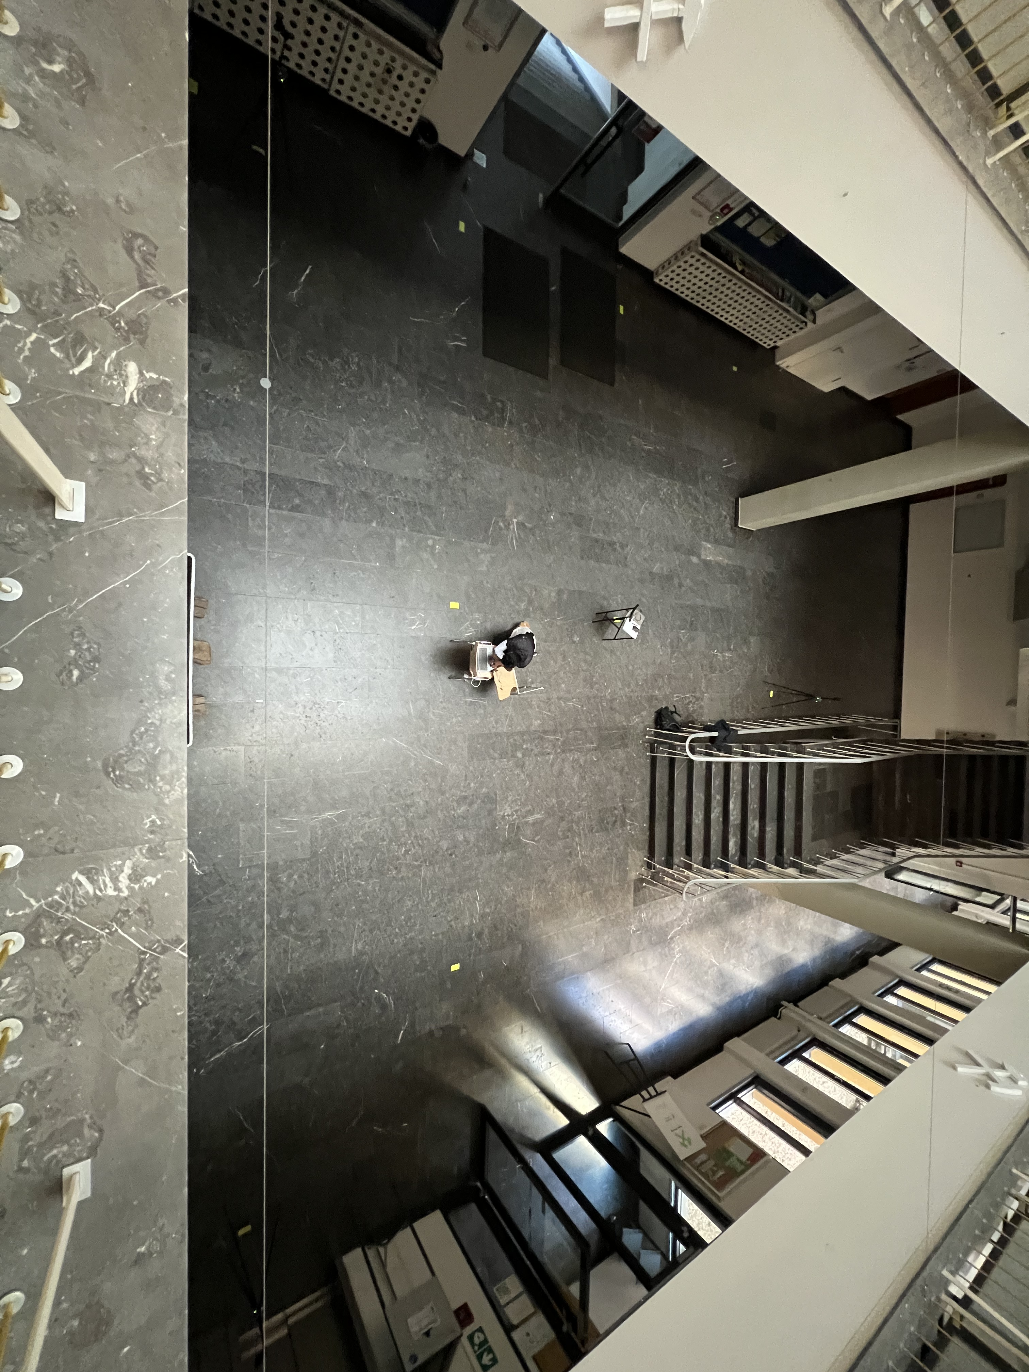

testing setup: 3 anchors with target in between
Anchor 3
Target
Anchor 1
Anchor 2

Slide 5
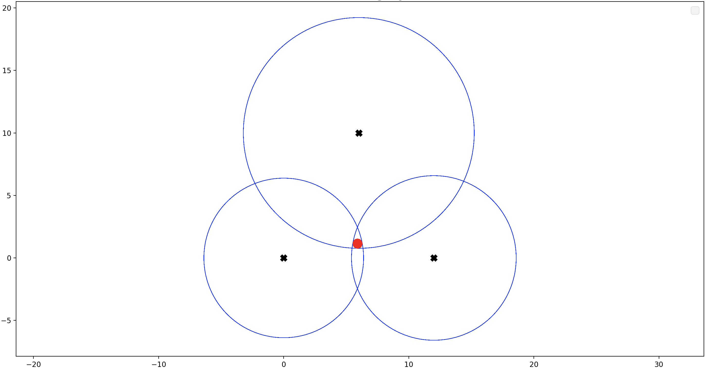
User interface and validation for static tests
2D Positioning System
Anchor 3
Y - Axis
Target Area
Anchor 1
Anchor 2
X - Axis

Slide 6
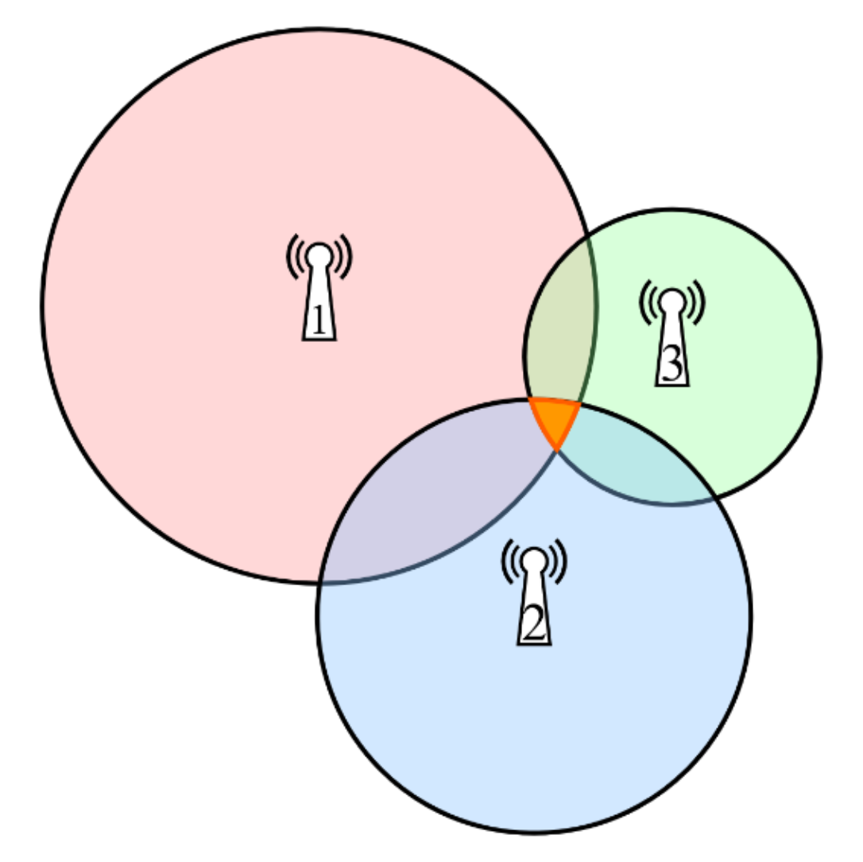
target point to target area transformation
with perfect accuracy
actual measurements
Y - Axis
Anchor 1

Slide 7
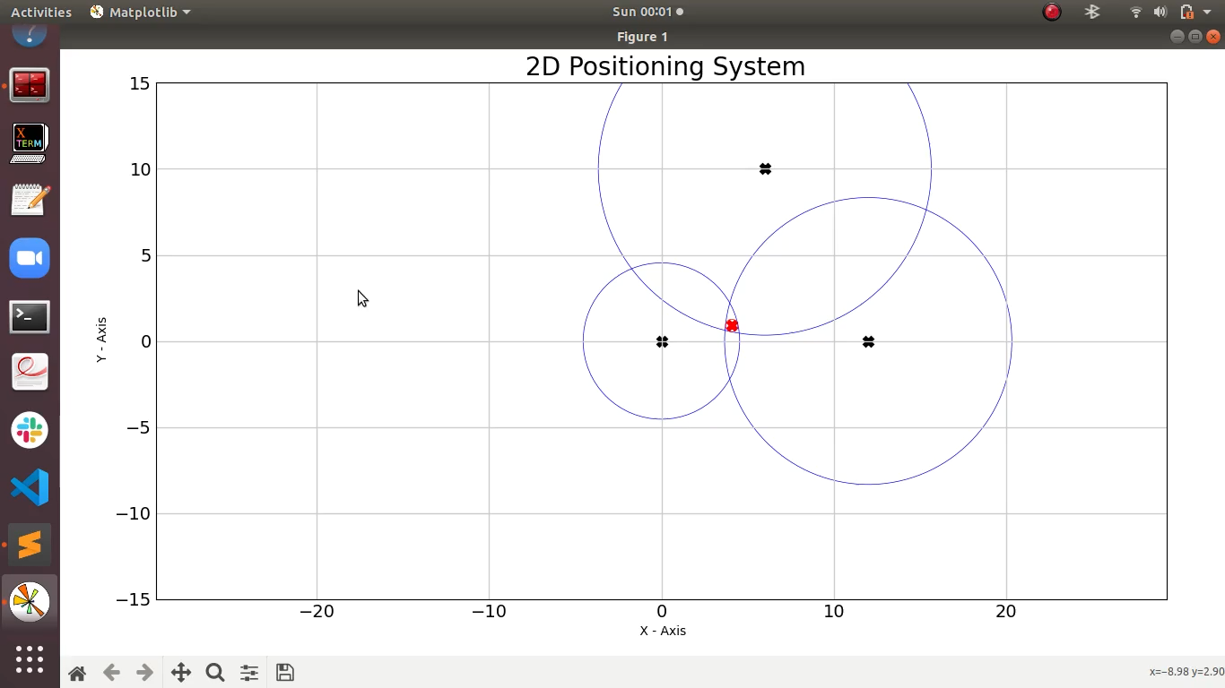
user interface and validation for dynamic tests

Slide 8
questions?

